Slide 1
INTRODUCTION TO GRAPHICS DISPLAYS & DEVICES
Course Title: Computer Graphics
Course Code: CSE - 413

Slide 2
Outlines
Types of graphics display used in refresh CRT screen(raster and random scan display )
Color CRT monitors
Direct View Storage Devices
Flat-panel display devices
Plasma Panel Display
LCD (Liquid Crystal Display)
LCD VS CRT
LED
LED VS LCD
Graphics Card or Display Adapters
Input-Output Devices
Output Devices

Slide 3
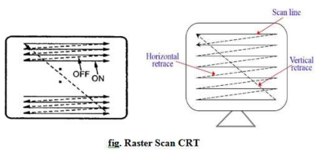
Raster scan display
A raster scan display is based on intensity control of pixels in the form of a rectangular box called raster on the screen.
In raster scan system electron beam sweeps across the screen from top to bottom cover one raw at a time and then back to top
When the beam is moved from L→R it is ON and
When the bean is moved from R →L it is OFF
In black & white picture only 1bit required to store ‘0’(black) or ‘1’ (white), in this case buffer referred as bitmap. In color picture multiple bits are required for pixel position, in this case buffer referred as pixmap

Slide 4
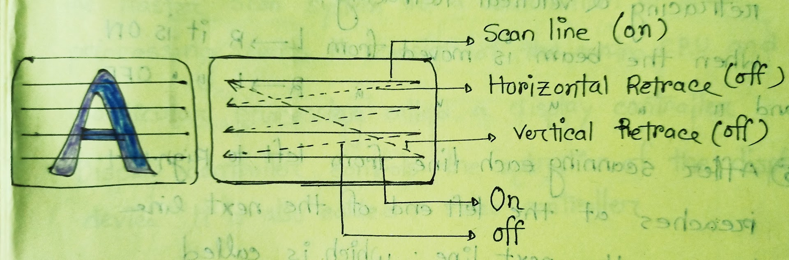
Raster Scan Display
Beam refreshing is two types. Horizontal retracing & vertical retracing
After scanning each line from left to right, it reaches at the left end of the next line to scan the next line; which is called horizontal retrace.
Similarly, after completing all lines in horizontal fashion it again reaches the top left corner to start rescanning the image and this is called vertical retrace. Normally, each vertical retrace takes 1/60th sec to avoid flickering
The raster scan system can store information of each pixel position, so it is suitable for realistic display of objects.
Raster scan provides a refresh rate of 60-80frames per second.
Used in CRT monitor based on tv technology.

Slide 5
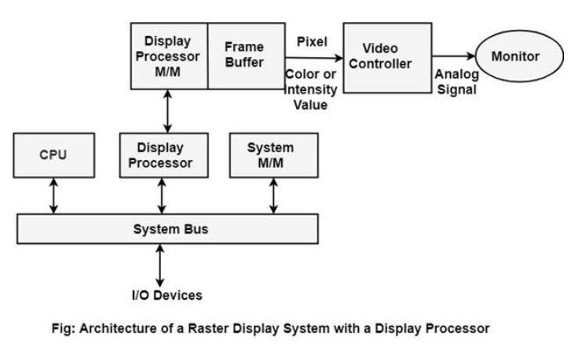
Raster-scan System
The raster scan system is a combination of some processing units. It consists of the control processing unit (CPU) and a particular processor called a display controller. Display Controller controls the operation of the display device. It is also called a video controller.

Slide 6
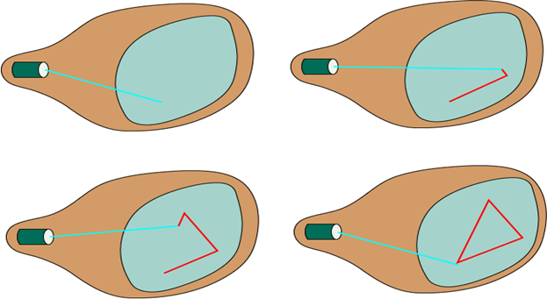
Random(vector) Scan Display
In this technique, the electron beam is directed only to the part of the screen where the picture is to be drawn. This displays directly traces out only the desired lines on CRT
To move the beam across the CRT, the information about both magnitude and direction is required. This information is generated with the help of vector graphics generator.
In this system image consist of a set of line drawing commands referred to as refresh display file.
Random scan display are designed to draw all the component lines of a picture 30 to 60 times per seconds.

Slide 7
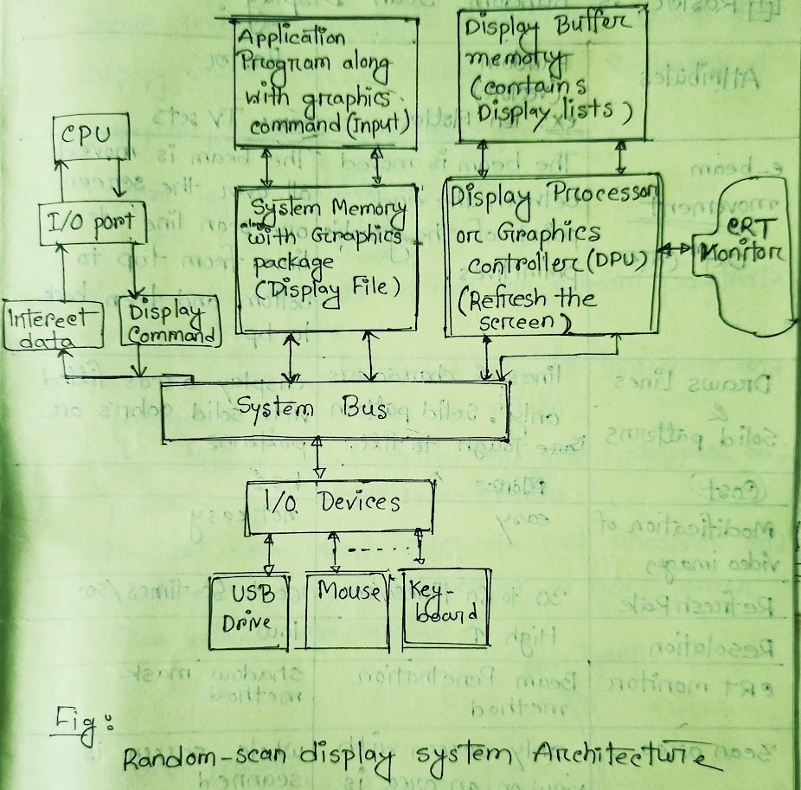
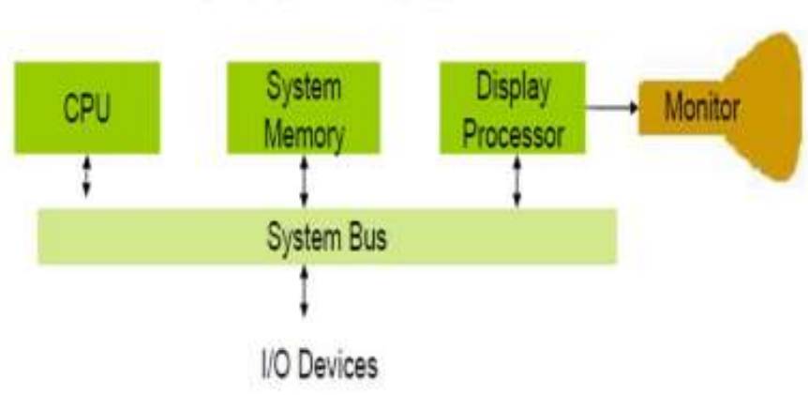
Random-Scan Systems
The organization of a simple random scan system is shown in following figure. An application program is input and stored in the system memory along with a graphics package. Graphics commands in the application program are translated by the graphics package into a display file stored in the system memory. This display file is then accessed by the display processor to refresh the screen. The display processor cycles through each command in the display file program once during every refresh cycle. Sometimes the display processor in a random scan system is referred to as a display processing unit or graphics controller

Slide 8
Random(vector) scan display vs Raster scan display
Attributes | Random(vector) scan display | Raster scan display
e-beam movement | The beam is moved between the end point of the graphics primitives | The beam is moved all over the screen one scan line at a time, from top to bottom and then back to top.
Draw line & solid patterns | Lines & characters only solid pattern tough to fill | Display areas filled with solid colors or patterns.
Cost | High | Less
Modification of video images | Easy | Not easy
Refresh rate | 30 to 60 times/sec | 60-80 times/sec
Resolution | High | Low
Scan area | Only screen with view on an area is displayed | Whole screen is scanned
Scan conversion | No required | Required
Suitable for | Polygon drawing | Realistic view
Examples | Pen, plotter | Tv sets

Slide 9
Color CRT Monitors
A CRT monitor displays color pictures by using a combination of phosphors that emit different colored light. With the combination of phosphor a range of colors can be displayed. There are two techniques used in color CRT monitors:
1. Beam Penetration Method
2. Shadow Mask Method

Slide 10
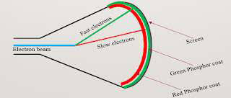
Beam Penetration Method
Beam penetration method is used with random scan display where CRT is coated with 2-layers of phosphor, usually red and green.
→ Outer layer is red phosphor
→ Inner layer is green phosphor
The Display color depend on how far e-beam penetrate the phosphor layers:-
1. Low e-beam speed strikes only red phosphor and produced red traces on screen.
2. High e-beam speed strikes the green phosphor and produces green traces on screen
3. Medium e-beam speed strikes the both phosphor and produces colors of combination of red & green like yellow and orange color.
Advantages:
-cheap
Dis-advantages:
-only 4-color produce
-Bad quality

Slide 11
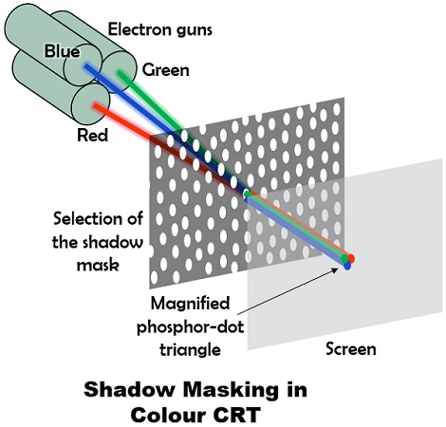
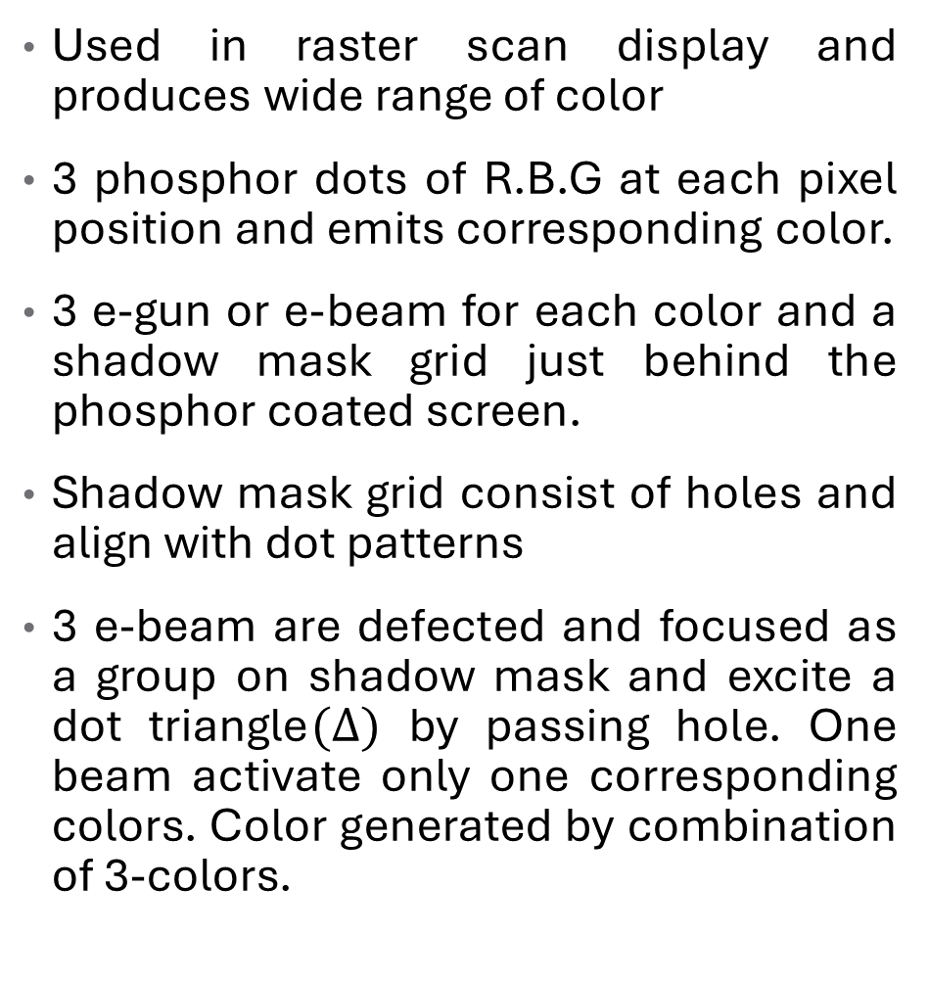
Shadow Mask Method
Used in raster scan display and produces wide range of color
3 phosphor dots of R.B.G at each pixel position and emits corresponding color.
3 e-gun or e-beam for each color and a shadow mask grid just behind the phosphor coated screen.
Shadow mask grid consist of holes and align with dot patterns
3 e-beam are defected and focused as a group on shadow mask and excite a dot triangle$(∆)$ by passing hole. One beam activate only one corresponding colors. Color generated by combination of 3-colors.

Slide 12
Beam Penetration Method Vs Shadow Mask Method
Attributes | Beam penetration method | Shadow mask method
Where used | Random scan display | Raster scan display
Color available | Red, green | Red, green, blue
Color generate | Only 4 color. Red, green, orange, yellow | Millions of colors can display
Color dependency | Only 4 colors are available because the colors depend on the speed of e-beam | Millions of color are available because the colors depends on the type of ray
Cost | low | High
Picture quality | Poor | Very realistic
Resolution | High | Low
E-gun | One e-gun is used | Three e-gun is used
Realistic view | Not suitable for realistic view | suitable

Slide 13
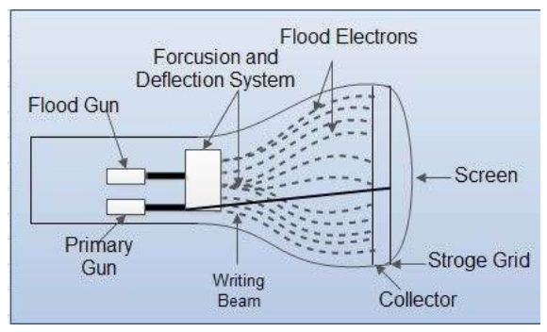
Direct View Storage Devices
Conceptually the Direct View Storage Tube (DVST) behaves like a CRT with highly persistent phosphor. Pictures drawn on there will be seen for several minutes (40-50 minutes) before fading. The term "storage tube" refers to the ability of the screen to retain the image which has been projected against it, thus avoiding the need to rewrite the image constantly.
1. Primary guns: It is used to store the picture pattern.
2. Flood gun or Secondary gun: It is used to maintain picture display
Advantage:
1. No refreshing is needed.
2. High Resolution
3. Cost is very less
Disadvantage:
1. It is not possible to erase the selected part of a picture.
2. It is not suitable for dynamic graphics applications.
3. If a part of picture is to modify, then time is consumed.

Slide 14
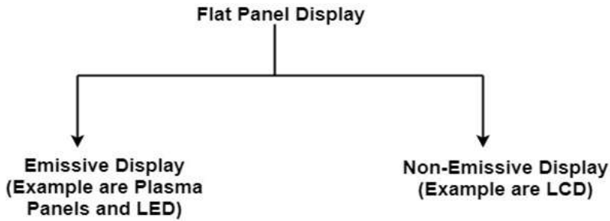
Flat-Panel Displays
This is emerging technology slowly replacing CRT monitors. The flat-panel displays have following properties: Little Volume, Light Weight, Lesser Power consumption
Example: Small T.V. monitor, calculator, pocket video games, laptop computers, an advertisement board in elevator.
1. Emissive Display: The emissive displays are devices that convert electrical energy into light. Examples are Plasma Panel, thin film electroluminescent display and LED (Light Emitting Diodes).
2. Non-Emissive Display: The Non-Emissive displays use optical effects to convert sunlight or light from some other source into graphics patterns. Examples are LCD (Liquid Crystal Device).

Slide 15
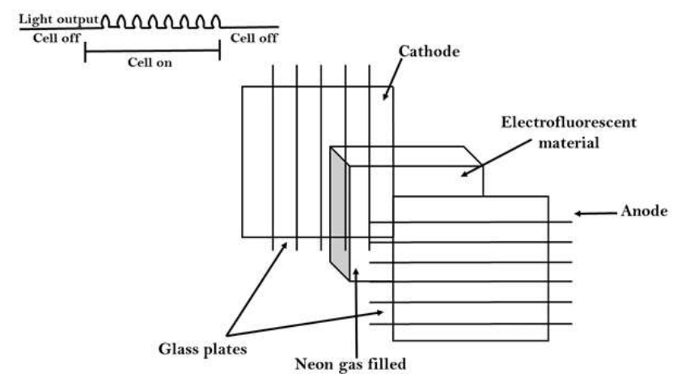
Plasma Panel Display
Plasma-Panels are also called as Gas-Discharge Display. It consists of an array of small lights. Lights are fluorescent in nature. The essential components of the plasma-panel display are:
1. Cathode: It consists of fine wires. It delivers negative voltage to gas cells. The voltage is released along with the negative axis.
2. Anode: It also consists of line wires. It delivers positive voltage. The voltage is supplied along positive axis.
3. Fluorescent cells: It consists of small pockets of gas liquids when the voltage is applied to this liquid (neon gas) it emits light.
4. Glass Plates: These plates act as capacitors. The voltage will be applied, the cell will glow continuously.
Advantage:
1. High Resolution
2. Large screen size is also possible.
3. Less Volume
4. Less weight
5. Flicker Free Display
Disadvantage:
1. Poor Resolution
2. Wiring requirement anode and the cathode is complex.
3. Its addressing is also complex.

Slide 16
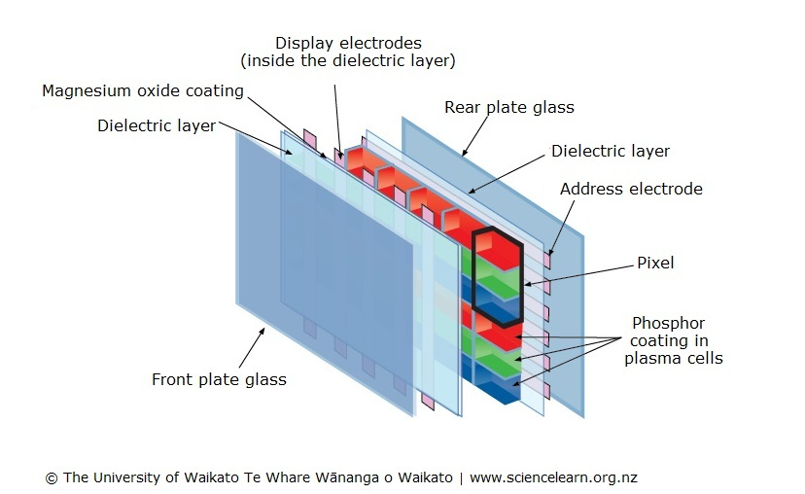
Plasma Panel Display

Slide 17
LCD (Liquid Crystal Display)

